Slide 1
CS162 Operating Systems and Systems Programming Lecture 15 Memory 2: Paging (Con’t), Caching and TLBs
March 9th, 2023
Prof. John Kubiatowicz
http://cs162.eecs.Berkeley.edu

Slide 2
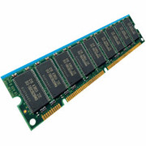
Recall: General Address translation
Virtual
Addresses
Physical
Addresses
CPU
MMU
Untranslated read or write
Consequently, two views of memory:
View from the CPU (what program sees, virtual memory)
View from memory (physical memory)
Translation box (Memory Management Unit or MMU) converts between the two views
Translation ⇒ much easier to implement protection!
If task A cannot even gain access to task B’s data, no way for A to adversely affect B
Extra benefit: every program can be linked/loaded into same region of user address space

Slide 3
Recall: Multi-Segment Model
Virtual
Address
offset
>
Error
Seg #
Offset
Base0
Limit0
V
Base1
Limit1
V
Base2
Limit2
V
Base2
Limit2
V
Physical
Address
Base3
Limit3
N
+
Base4
Limit4
V
Base5
Limit5
N
Base6
Limit6
N
Base7
Limit7
V
Check Valid
Segment map resides in processor
Segment number mapped into base/limit pair
Base added to offset to generate physical address
Error check catches offset out of range
As many chunks of physical memory as entries
Segment addressed by portion of virtual address
However, could be included in instruction instead:
x86 Example: mov [es:bx],ax.
What is “V/N” (valid / not valid)?
Can mark segments as invalid; requires check as well
Access
Error

Slide 4
Problems with Segmentation
Must fit variable-sized chunks into physical memory
May move processes multiple times to fit everything
Limited options for swapping to disk
Fragmentation: wasted space
External: free gaps between allocated chunks
Internal: don’t need all memory within allocated chunks

Slide 5
Paging: Physical Memory in Fixed Size Chunks
Solution to fragmentation from segments?
Allocate physical memory in fixed size chunks (“pages”)
Every chunk of physical memory is equivalent
Can use simple vector of bits to handle allocation: 00110001110001101 … 110010
Each bit represents page of physical memory 1 ⇒ allocated, 0 ⇒ free
Should pages be as big as our previous segments?
No: Can lead to lots of internal fragmentation
Typically have small pages (1K-16K)
Consequently: need multiple pages/segment

Slide 6
How to Implement Simple Paging?
Virtual Address:
Virtual
Page #
Offset
PageTablePtr
page #0
V,R
Physical
Page #
Offset
page #1
V,R
page #1
V,R
page #2
V,R,W
Physical Address
PageTableSize
>
page #3
V,R,W
Check Perm
Access Error
page #4
N
page #5
V,R,W
Access
Error
Page Table (One per process)
Resides in physical memory
Contains physical page and permission for each virtual page (e.g. Valid bits, Read, Write, etc)
Virtual address mapping
Offset from Virtual address copied to Physical Address
Example: 10 bit offset ⇒ 1024-byte pages
Virtual page # is all remaining bits
Example for 32-bits: 32-10 = 22 bits, i.e. 4 million entries
Physical page # copied from table into physical address
Check Page Table bounds and permissions

Slide 7
Simple Page Table Example
Example (4 byte pages)
0x00
0000 0000
0x00
a
b
c
d
0001 0000
0x04
0
4
i
j
k
l
0x04
0000 0100
1
0000 1100
0x05!
e
f
g
h
3
2
1
0000 0100
0x08
0x06?
0x08
0000 1000
Page
Table
0x0C
i
j
k
l
e
f
g
h
0x09?
0x0E!
0x10
Virtual
Memory
0000 0110
0000 1110
a
b
c
d
0000 1001
0000 0101
Physical
Memory
Notes:
What is virtual address 0x6? 1|10 = 3|2 = 0xE
What is virtual address 0x9? 10|01 = 1|1 = 0x5

Slide 8
What about Sharing?
Virtual Address
(Process A):
Virtual
Page #
Offset
PageTablePtrA
page #0
V,R
page #1
V,R
page #2
V,R,W
page #2
V,R,W
page #3
V,R,W
Shared
Page
page #4
N
page #5
V,R,W
PageTablePtrB
page #0
V,R
page #1
N
This physical page
appears in address
space of both processes
page #2
V,R,W
page #3
N
page #4
V,R
page #4
V,R
page #5
V,R,W
Virtual Address
(Process B):
Virtual
Page #
Offset

Slide 9
Where is page sharing used ?
The “kernel region” of every process has the same page table entries
The process cannot access it at user level
But on U->K switch, kernel code can access it AS WELL AS the region for THIS user
What does the kernel need to do to access other user processes?
Different processes running same binary!
Execute-only, but do not need to duplicate code segments
User-level system libraries (execute only)
Shared-memory segments between different processes
Can actually share objects directly between processes
Must map page into same place in address space!
This is a limited form of the sharing that threads have within a single process

Slide 10
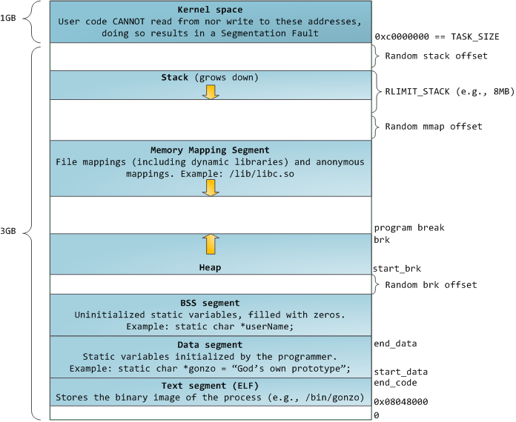
Recall: Memory Layout for Linux 32-bit (Pre-Meltdown patch!)
http://static.duartes.org/img/blogPosts/linuxFlexibleAddressSpaceLayout.png

Slide 11
Some simple security measures
Address Space Randomization
Position-Independent Code ⇒ can place user code anywhere in address space
Random start address makes much harder for attacker to cause jump to code that it seeks to take over
Stack & Heap can start anywhere, so randomize placement
Kernel address space isolation
Don’t map whole kernel space into each process, switch to kernel page table
Meltdown⇒map none of kernel into user mode!

Slide 12
Summary: Paging
Virtual memory view
Page Table
11111 11101
11110 11100
11101 null
11100 null
11011 null
11010 null
11001 null
11000 null
10111 null
10110 null
10101 null
10100 null
10011 null
10010 10000
10001 01111
10000 01110
01111 null
01110 null
01101 null
01100 null
01011 01101
01010 01100
01001 01011
01000 01010
00111 null
00110 null
00101 null
00100 null
00011 00101
00010 00100
00001 00011
00000 00010
Physical memory view
1111 1111
1110 1111
1111 0000
stack
stack
1110 0000
1100 0000
heap
1000 0000
heap
0111 000
data
data
0101 000
0100 0000
code
code
0001 0000
0000 0000
0000 0000
page #
offset

Slide 13
Summary: Paging
Virtual memory view
Page Table
11111 11101
11110 11100
11101 null
11100 null
11011 null
11010 null
11001 null
11000 null
10111 null
10110 null
10101 null
10100 null
10011 null
10010 10000
10001 01111
10000 01110
01111 null
01110 null
01101 null
01100 null
01011 01101
01010 01100
01001 01011
01000 01010
00111 null
00110 null
00101 null
00100 null
00011 00101
00010 00100
00001 00011
00000 00010
Physical memory view
1111 1111
stack
1110 0000
stack
1110 0000
1100 0000
What happens if stack grows to 1110 0000?
heap
1000 0000
heap
0111 000
data
data
0101 000
0100 0000
code
code
0001 0000
0000 0000
0000 0000
page #
offset

Slide 14
Summary: Paging
Virtual memory view
Page Table
11111 11101
11110 11100
11101 10111
11100 10110
11011 null
11010 null
11001 null
11000 null
10111 null
10110 null
10101 null
10100 null
10011 null
10010 10000
10001 01111
10000 01110
01111 null
01110 null
01101 null
01100 null
01011 01101
01010 01100
01001 01011
01000 01010
00111 null
00110 null
00101 null
00100 null
00011 00101
00010 00100
00001 00011
00000 00010
Physical memory view
1111 1111
stack
1110 0000
stack
1110 0000
1100 0000
stack
Allocate new pages where room!
heap
1000 0000
heap
0111 000
data
data
0101 000
Challenge: Table size equal to # of pages in virtual memory!
0100 0000
code
code
0001 0000
0000 0000
0000 0000
page #
offset

Slide 15
Administrivia
Midterm 2 is next week!
Wednesday, 3/15 from 8-10PM in 150 Wheeler Hall
You get 2 pages of hand written double-sided notes
Fill out any remaining conflicts by Friday (tomorrow!)
Project 2 design document due Friday (tomorrow!)
Kubi’s office hours (673 Soda Hall)
Monday 2-3
Wednesday 3-4

Slide 16
How big do things get?
32-bit address space => 2³² bytes (4 GB)
Note: “b” = bit, and “B” = byte
And for memory:
“K”(kilo) = 2¹⁰ = 1024 ≈ 10³ (But not quite!): Sometimes called “Ki” (Kibi)
“M”(mega) = 2²⁰ = (1024)² = 1,048,576 ≈ 10⁶ (But not quite!): Sometimes called “Mi” (Mibi)
“G”(giga) = 2³⁰ = (1024)³ = 1,073,741,824 ≈ 10⁹ (But not quite!): Sometimes called “Gi” (Gibi)
Typical page size: 4 KB
how many bits of the address is that ? (remember 2¹⁰ = 1024)
Ans – 4KB = 4×2¹⁰ = 2¹² ⇒ 12 bits of the address
So how big is the simple page table for each process?
2³²/2¹² = 2²⁰ (that’s about a million entries) x 4 bytes each => 4 MB
When 32-bit machines got started (vax 11/780, intel 80386), 16 MB was a LOT of memory
How big is a simple page table on a 64-bit processor (x86_64)?
2⁶⁴/2¹² = 2⁵²(that’s 4.5×10¹⁵ or 4.5 exa-entries)×8 bytes each = 36×10¹⁵ bytes or 36 exa-bytes!!!! This is a ridiculous amount of memory!
This is really a lot of space – for only the page table!!!
The address space is sparse, i.e. has holes that are not mapped to physical memory
So, most of this space is taken up by page tables mapped to nothing

Slide 17
Page Table Discussion
What needs to be switched on a context switch?
Page table pointer and limit
What provides protection here?
Translation (per process) and dual-mode!
Can’t let process alter its own page table!
Analysis
Pros
Simple memory allocation
Easy to share
Con: What if address space is sparse?
E.g., on UNIX, code starts at 0, stack starts at (2³¹-1)
With 1K pages, need 2 million page table entries!
Con: What if table really big?
Not all pages used all the time ⇒ would be nice to have working set of page table in memory
Simple Page table is way too big!
Does it all need to be in memory?
How about multi-level paging?
or combining paging and segmentation
Notes:
What if page size is very small? VAX had a 512-byte page size = lots of space for page table entries
What if page size is really big? Wastes space inside of page (internal fragmentation)

Slide 18
How to Structure a Page Table
Page Table is a map (function) from VPN to PPN
Simple page table corresponds to a very large lookup table
VPN is index into table, each entry contains PPN
What other map structures can you think of?
Trees?
Hash Tables?
Page
Table
Virtual Address
Physical Address

Slide 19
Fix for sparse address space: The two-level page table
Physical
Address:
Physical
Page #
Offset
10 bits
10 bits
12 bits
Virtual
Address:
Virtual
P1 index
Virtual
P2 index
Offset
4KB
PageTablePtr
Tree of Page Tables
“Magic” 10b-10b-12b pattern!
Tables fixed size (1024 entries)
On context-switch: save single PageTablePtr register (i.e. CR3)
Valid bits on Page Table Entries
Don’t need every 2nd-level table
Even when exist, 2nd-level tables can reside on disk if not in use
4 bytes
4 bytes

Slide 20
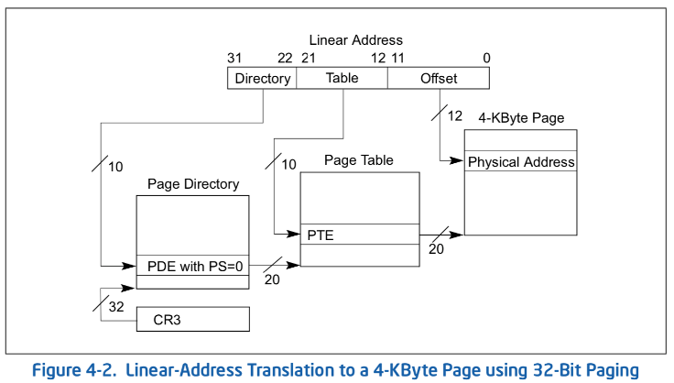
Example: x86 classic 32-bit address translation
Intel terminology: Top-level page-table called a “Page Directory”
With “Page Directory Entries”
CR3 provides physical address of the page directory
This is what we have called the “PageTablePtr” in previous slides
Change in CR3 changes the whole translation table!

Slide 21
What is in a Page Table Entry (PTE)?
What is in a Page Table Entry (or PTE)?
Pointer to next-level page table or to actual page
Permission bits: valid, read-only, read-write, write-only
Example: Intel x86 architecture PTE:
Address same format previous slide (10, 10, 12-bit offset)
Intermediate page tables called “Directories”
P: Present (same as “valid” bit in other architectures)
W: Writeable
U: User accessible
PWT: Page write transparent: external cache write-through
PCD: Page cache disabled (page cannot be cached)
A: Accessed: page has been accessed recently
D: Dirty (PTE only): page has been modified recently
PS: Page Size: PS=1⇒4MB page (directory only). Bottom 22 bits of virtual address serve as offset
Page Frame Number
(Physical Page Number)
Free
(OS)
0
PS
D
A
PCD
PWT
U
W
P
31-12
11-9
8
7
6
5
4
3
2
1
0

Slide 22
Examples of how to use a PTE
How do we use the PTE?
Invalid PTE can imply different things:
Region of address space is actually invalid or
Page/directory is just somewhere else than memory
Validity checked first
OS can use other (say) 31 bits for location info
Usage Example: Demand Paging
Keep only active pages in memory
Place others on disk and mark their PTEs invalid
Usage Example: Copy on Write
UNIX fork gives copy of parent address space to child
Address spaces disconnected after child created
How to do this cheaply?
Make copy of parent’s page tables (point at same memory)
Mark entries in both sets of page tables as read-only
Page fault on write creates two copies
Usage Example: Zero Fill On Demand
New data pages must carry no information (say be zeroed)
Mark PTEs as invalid; page fault on use gets zeroed page
Often, OS creates zeroed pages in background

Slide 23
Sharing with multilevel page tables
10 bits
10 bits
12 bits
Physical
Page #
Offset
Virtual
Address:
Virtual
P1 index
Virtual
P2 index
Offset
4KB
PageTablePtr
PageTablePtr’
Entire regions of the address space can be efficiently shared

Slide 24
Summary: Two-Level Paging
Virtual memory view
Page Table
(level 1)
Page Tables
(level 2)
Physical memory view
1111 1111
stack
11 11101
10 11100
01 10111
00 10110
stack
1110 0000
1111 0000
1100 0000
stack
111
110 null
101 null
100
011 null
010
001 null
000
11 null
10 10000
01 01111
00 01110
heap
1000 0000
heap
0111 000
11 01101
10 01100
01 01011
00 01010
data
data
0101 000
0100 0000
11 00101
10 00100
01 00011
00 00010
code
page2 #
code
0001 0000
0000 0000
0000 0000
page1 #
offset

Slide 25
Summary: Two-Level Paging
Virtual memory view
Page Table
(level 1)
Page Tables
(level 2)
Physical memory view
stack
11 11101
10 11100
01 10111
00 10110
stack
1110 0000
stack
111
110 null
101 null
100
011 null
010
001 null
000
11 null
10 10000
01 01111
00 01110
1001 0000
(0x90)
heap
heap
1000 0000
(0x80)
In best case, total size of page tables ≈ number of pages used by program virtual memory. Requires two additional memory accesses!
11 01101
10 01100
01 01011
00 01010
data
data
11 00101
10 00100
01 00011
00 00010
code
code
0001 0000
0000 0000

Slide 26
Multi-level Translation: Segments + Pages
What about a tree of tables?
Lowest level page table ⇒ memory still allocated with bitmap
Higher levels often segmented
Could have any number of levels. Example (top segment):
What must be saved/restored on context switch?
Contents of top-level segment registers (for this example)
Pointer to top-level table (page table)
Virtual
Address:
Virtual
Seg #
Virtual
Page #
Offset
page #0
V,R
Base0
Limit0
V
page #1
V,R
Physical
Page #
Offset
page #2
V,R,W
Base1
Limit1
V
page #2
V,R,W
Physical Address
Base2
Limit2
V
page #3
V,R,W
Base2
Limit2
V
Base3
Limit3
N
page #4
N
Base4
Limit4
V
page #5
V,R,W
Check Permissions
Base5
Limit5
N
Base6
Limit6
N
Base7
Limit7
V
>
Access
Error
Access
Error

Slide 27
What about Sharing (Complete Segment)?
Process A:
Virtual
Seg #
Virtual
Page #
Offset
page #0
V,R
page #1
V,R
page #2
V,R,W
Base0
Limit0
V
page #3
V,R,W
Base1
Limit1
V
page #4
N
Base2
Limit2
V
Base2
Limit2
V
page #5
V,R,W
Base3
Limit3
N
Base4
Limit4
V
Shared Segment
Base5
Limit5
N
Base6
Limit6
N
Base0
Limit0
V
Base7
Limit7
V
Base1
Limit1
V
Base2
Base2
Limit2
Limit2
V
V
Base3
Limit3
N
Base4
Limit4
V
Base5
Limit5
N
Base6
Limit6
N
Base7
Limit7
V
Process B:
Virtual
Seg #
Virtual
Page #
Offset

Slide 28
Multi-level Translation Analysis
Pros:
Only need to allocate as many page table entries as we need for application
In other wards, sparse address spaces are easy
Easy memory allocation
Easy Sharing
Share at segment or page level (need additional reference counting)
Cons:
One pointer per page (typically 4K – 16K pages today)
Page tables need to be contiguous
However, the 10b-10b-12b configuration keeps tables to exactly one page in size
Two (or more, if >2 levels) lookups per reference
Seems very expensive!

Slide 29
Recall: Dual-Mode Operation
Can a process modify its own translation tables? NO!
If it could, could get access to all of physical memory (no protection!)
To Assist with Protection, Hardware provides at least two modes (Dual-Mode Operation):
“Kernel” mode (or “supervisor” or “protected”)
“User” mode (Normal program mode)
Mode set with bit(s) in control register only accessible in Kernel mode
Kernel can easily switch to user mode; User program must invoke an exception of some sort to get back to kernel mode (more in moment)
Note that x86 model actually has more modes:
Traditionally, four “rings” representing priority; most OSes use only two:
Ring 0 ⇒ Kernel mode, Ring 3 ⇒ User mode
Called “Current Privilege Level” or CPL
Newer processors have additional mode for hypervisor (“Ring -1”)
Certain operations restricted to Kernel mode:
Modifying page table base (CR3 in x86), and segment descriptor tables
Have to transition into Kernel mode before you can change them!
Also, all page-table pages must be mapped only in kernel mode

Slide 30
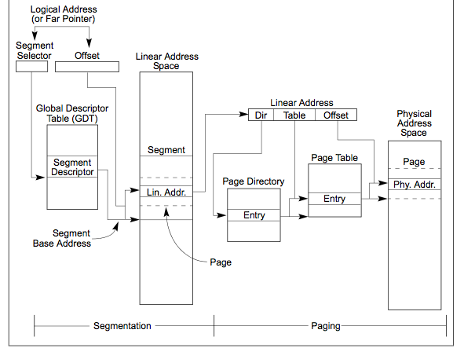
Making it real: X86 Memory model with segmentation (16/32-bit)
Segment Selector from instruction: mov eax, gs(0x0)
2-level page table in 10-10-12 bit address
Second level
called “table”
Combined address
Is 32-bit “linear”
Virtual address
First level
called “directory”

Slide 31

X86 Segment Descriptors (32-bit Protected Mode)
Segments are implicit in the instruction (e.g. code segments) or part of the instruction
There are 6 registers: SS, CS, DS, ES, FS, GS
What is in a segment register?
A pointer to the actual segment description:
G/L selects between GDT and LDT tables (global vs local descriptor tables)
RPL: Requestor’s Privilege Level (RPL of CS ⇒ Current Privilege Level)
Two registers: GDTR/LDTR hold pointers to global/local descriptor tables in memory
Descriptor format (64 bits):
G: Granularity of segment [ Limit Size ] (0: bytes, 1: 4KiB unit) DB: Default operand size (0: 16bit, 1: 32bit) A: Programmer definable (no hardware meaning) P: Segment present DPL: Descriptor Privilege Level: Access requires Max(CPL,RPL)≤DPL S: System Segment (0: System, 1: code or data) Type: Code, Data, Segment
Segment selector [13 bits]
G/L
RPL
Segment Register

Slide 32
How are segments used?
One set of global segments (GDT) for everyone, different set of local segments (LDT) for every process
In legacy applications (16-bit mode):
Segments provide protection for different components of user programs
Separate segments for chunks of code, data, stacks
RPL of Code Segment ⇒CPL (Current Privilege Level)
Limited to 64K segments
Modern use in 32-bit Mode:
Even though there is full segment functionality, segments are set up as “flattened”, i.e. every segment is 4GB in size
One exception: Use of GS (or FS) as a pointer to “Thread Local Storage” (TLS)
A thread can make accesses to TLS like this: mov eax, gs(0x0)
Modern use in 64-bit (“long”) mode
Most segments (SS, CS, DS, ES) have zero base and no length limits
Only FS and GS retain their functionality TLS

Slide 33
X86_64: Four-level page table!
9 bits
9 bits
9 bits
9 bits
12 bits
48-bit Virtual
Address:
Virtual
P1 index
Virtual
P2 index
Virtual
P3 index
Virtual
P4 index
Offset
PageTablePtr
8 bytes
4096-byte pages (12 bit offset) Page tables also 4k bytes (pageable)
Physical
Address:
(40-50 bits)
Physical Page #
12bit Offset

Slide 34
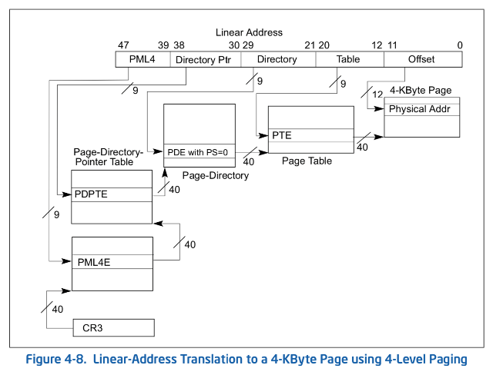
From x86_64 architecture specification
All current x86 processor support a 64 bit operation
64-bit words (so ints are 8 bytes) but 48-bit addresses

Slide 35
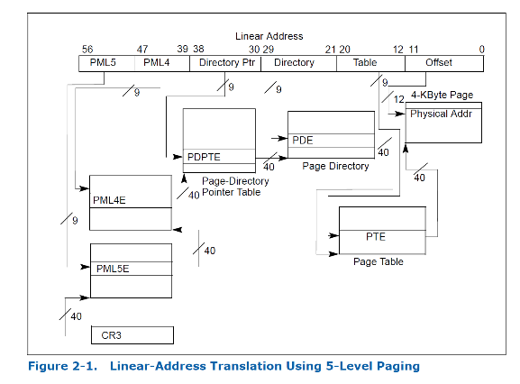
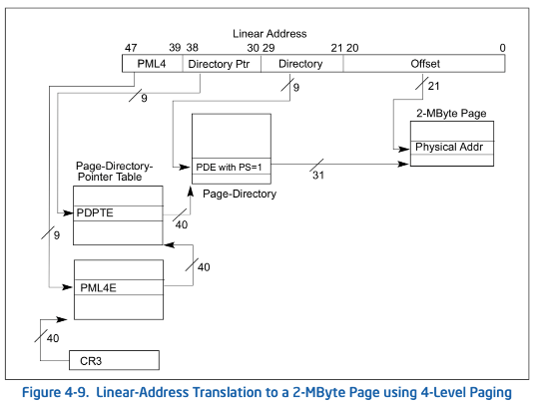
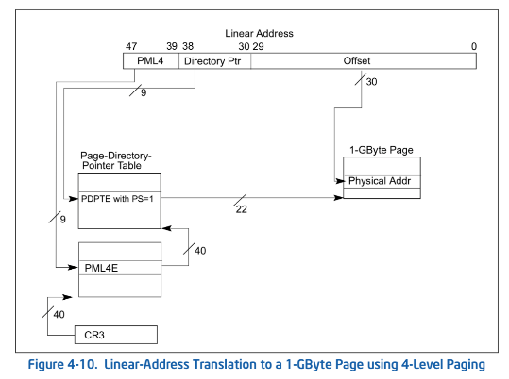
Larger page sizes supported as well
Larger page sizes (2MB, 1GB) make sense since memory is now cheap
Great for kernel, large libraries, etc
Use limited primarily by internal fragmentation…

Slide 36
IA64: 64bit addresses: Six-level page table?!?
64bit Virtual
Address:
7 bits
9 bits
9 bits
9 bits
9 bits
9 bits
12 bits
Virtual
P1 index
Virtual
P2 index
Virtual
P3 index
Virtual
P4 index
Virtual
P5 index
Virtual
P6 index
Offset
No!
Too slow
Too many almost-empty tables
Notes:
Only really use last two levels (1 GB)

Slide 37
Alternative: Inverted Page Table
With all previous examples (“Forward Page Tables”)
Size of page table is at least as large as amount of virtual memory allocated to processes
Physical memory may be much less
Much of process space may be out on disk or not in use
Answer: use a hash table
Called an “Inverted Page Table”
Size is independent of virtual address space
Directly related to amount of physical memory
Very attractive option for 64-bit address spaces
PowerPC, UltraSPARC, IA64
Cons:
Complexity of managing hash chains: Often in hardware!
Poor cache locality of page table
Virtual
Page #
Offset
Hash
Table
Physical
Page #
Offset
Total size of page table ≈ number of pages used by program in physical memory. Hash more complex

Slide 38
Address Translation Comparison
 | Advantages | Disadvantages
Simple Segmentation | Fast context switching (segment map maintained by CPU) | External fragmentation
Paging (Single-Level) | No external fragmentation Fast and easy allocation | Large table size (~ virtual memory) Internal fragmentation
Paged Segmentation | Table size ~ # of pages in virtual memory Fast and easy allocation | Multiple memory references per page access
Multi-Level Paging
Inverted Page Table | Table size ~ # of pages in physical memory | Hash function more complex No cache locality of page table

Slide 39
How is the Translation Accomplished?
Virtual
Addresses
Physical
Addresses
CPU
MMU
The MMU must translate virtual address to physical address on:
Every instruction fetch
Every load
Every store
What does the MMU need to do to translate an address?
1-level Page Table
Read PTE from memory, check valid, merge address
Set “accessed” bit in PTE, Set “dirty bit” on write
2-level Page Table
Read and check first level
Read, check, and update PTE
N-level Page Table …
MMU does page table Tree Traversal to translate each address

Slide 40
Where and What is the MMU ?
Read <Phs_Addr X >
Physical
Memory
Read <V_Addr m>
Processor
(core)
pgm data
MMU
Cache(s)
Memory Bus
PTBR
page tables
< data @ mem[VtoP(m)] >
The processor requests READ Virtual-Address to memory system
Through the MMU to the cache (to the memory)
Some time later, the memory system responds with the data stored at the physical address (resulting from virtual → physical) translation
Fast on a cache hit, slow on a miss
So what is the MMU doing?
On every reference (I-fetch, Load, Store) read (multiple levels of) page table entries to get physical frame or FAULT
Through the caches to the memory
Then read/write the physical location

Slide 41
Recall: CS61c Caching Concept
Cache: a repository for copies that can be accessed more quickly than the original
Make frequent case fast and infrequent case less dominant
Caching underlies many techniques used today to make computers fast
Can cache: memory locations, address translations, pages, file blocks, file names, network routes, etc…
Only good if:
Frequent case frequent enough and
Infrequent case not too expensive
Important measure: Average Access time = (Hit Rate x Hit Time) + (Miss Rate x Miss Time)

Slide 42
Recall: In Machine Structures (eg. 61C) …
Caching is the key to memory system performance
Main
Memory
(DRAM)
Processor
Access time = 100ns
Main
Memory
(DRAM)
Cache
(SRAM)
Processor
1 ns
100ns
Average Memory Access Time (AMAT)
= (Hit Rate x HitTime) + (Miss Rate x MissTime)
Where HitRate + MissRate = 1
HitRate = 90% => AMAT = (0.9 x 1) + (0.1 x 101)=11 ns
HitRate = 99% => AMAT = (0.99 x 1) + (0.01 x 101)=2.01 ns
MissTime_{L1} includes HitTime_{L1}+MissPenalty_{L1} ≡ HitTime_{L1} +AMAT_{L2}
Notes:
So, the role of a cache is to reduce the average memory access time. So, here we have a processor; if it directly needs to go to memory to access something, it takes 100ns.
Remember, processors are superfast, they compute in small cycles, and hence 100ns is a really long time for them.
If we add a second level cache, we can instead access the same data in 10ns, i.e.,10 times faster than directly going to memory.
To quantify the gain due to a cache, we can compute the average access time: and its simply the hit-rate (times we find it in the cache). …
So, we get an illusion that we can access the main memory at such a fast speed, due to caching.

Slide 43
Another Major Reason to Deal with Caching
Virtual
Address:
Virtual
Seg #
Virtual
Page #
Offset
Cannot afford to translate on every access
At least three DRAM accesses per actual DRAM access
Or: perhaps I/O if page table partially on disk!
Even worse: What if we are using caching to make memory access faster than DRAM access?
Solution? Cache translations!
Translation Cache: TLB (“Translation Lookaside Buffer”)
page #0
V,R
Base0
Limit0
V
page #1
V,R
Physical
Page #
Offset
Base1
Limit1
V
page #2
V,R,W
Physical Address
Base2
Limit2
V
page #3
V,R,W
Base3
Limit3
N
page #4
N
Base4
Limit4
V
page #5
V,R,W
Check Perm
Base5
Limit5
N
Base6
Limit6
N
Base7
Limit7
V
>
Access
Error
Access
Error

Slide 44
Why Does Caching Help? Locality!
Probability
of reference
0
Address Space
2^{n} - 1
Temporal Locality (Locality in Time):
Keep recently accessed data items closer to processor
Spatial Locality (Locality in Space):
Move contiguous blocks to the upper levels
Lower Level
Memory
To Processor
Upper Level
Memory
Blk X
From Processor
Blk Y
Notes:
How does the memory hierarchy work? Well it is rather simple, at least in principle.
In order to take advantage of the temporal locality, that is the locality in time, the memory hierarchy will keep those more recently accessed data items closer to the processor because chances are (points to the principle), the processor will access them again soon.
In order to take advantage of the spatial locality, not ONLY do we move the item that has just been accessed to the upper level, but we ALSO move the data items that are adjacent to it.
+1 = 15 min. (X:55)

Slide 45
Recall: Memory Hierarchy
Caching: Take advantage of the principle of locality to:
Present the illusion of having as much memory as in the cheapest technology
Provide average speed similar to that offered by the fastest technology
Address Translation needs to occur here
Page table lives here (perhaps cached)
Processor
Secondary Storage (Disk)
Core
L2 Cache
Registers
L1 Cache
Secondary Storage (SSD)
Main
Memory
(DRAM)
L3 Cache (shared)
Core
L2 Cache
Registers
L1 Cache
Speed (ns):
0.3
1
3
10-30
100
100,000 (0.1 ms)
10,000,000
(10 ms)
Size (bytes):
100Bs
10kBs
100kBs
MBs
GBs
100GBs
TBs
Notes:
The design goal is to present the user with as much memory as is available in the cheapest technology (points to the disk).
While by taking advantage of the principle of locality, we like to provide the user an average access speed that is very close to the speed that is offered by the fastest technology.
(We will go over this slide in details in the next lecture on caches).
+1 = 16 min. (X:56)

Slide 46
How do we make Address Translation Fast?
Cache results of recent translations !
Different from a traditional cache
Cache Page Table Entries using Virtual Page # as the key
Read <Phs_Addr X >
Physical
Memory
Read <V_Addr m>
Processor
(core)
pgm data
MMU
Cache(s)
Memory Bus
PTBR
page tables
V_Pg M₁ : <Phs_Frame #₁, V, … >
V_Pg M₂ : <Phs_Frame #₂, V, … >
V_Pg M_{k} : <Phs_Frame #_{k}, V, … >

Slide 47
Translation Look-Aside Buffer
Record recent Virtual Page # to Physical Frame # translation
If present, have the physical address without reading any of the page tables !!!
Even if the translation involved multiple levels
Caches the end-to-end result
Was invented by Sir Maurice Wilkes – prior to caches
When you come up with a new concept, you get to name it!
People realized “if it’s good for page tables, why not the rest of the data in memory?”
On a TLB miss, the page tables may be cached, so only go to memory when both miss

Slide 48
Caching Applied to Address Translation
Virtual
Address
TLB
Physical
Memory
CPU
Physical
Address
Cached?
Yes
No
Save
Result
Translate
(MMU)
Data Read or Write
(untranslated)
Question is one of page locality: does it exist?
Instruction accesses spend a lot of time on the same page (since accesses sequential)
Stack accesses have definite locality of reference
Data accesses have less page locality, but still some…
Can we have a TLB hierarchy?
Sure: multiple levels at different sizes/speeds

Slide 49
Conclusion
Page Tables
Memory divided into fixed-sized chunks of memory
Virtual page number from virtual address mapped through page table to physical page number
Offset of virtual address same as physical address
Large page tables can be placed into virtual memory
Multi-Level Tables
Virtual address mapped to series of tables
Permit sparse population of address space
Inverted Page Table
Use of hash-table to hold translation entries
Size of page table ~ size of physical memory rather than size of virtual memory
The Principle of Locality:
Program likely to access a relatively small portion of the address space at any instant of time.
Temporal Locality: Locality in Time
Spatial Locality: Locality in Space

